Slide 1

RGB-D object recognition and localization with clutter and occlusions
Federico Tombari, Samuele Salti, Luigi Di Stefano Computer Vision Lab – University of Bologna Bologna, Italy

Slide 2
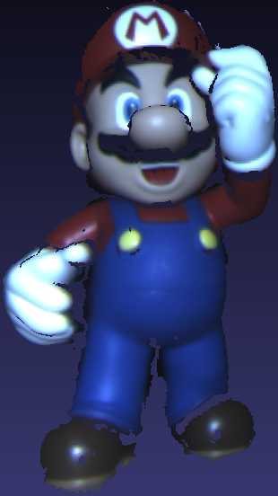
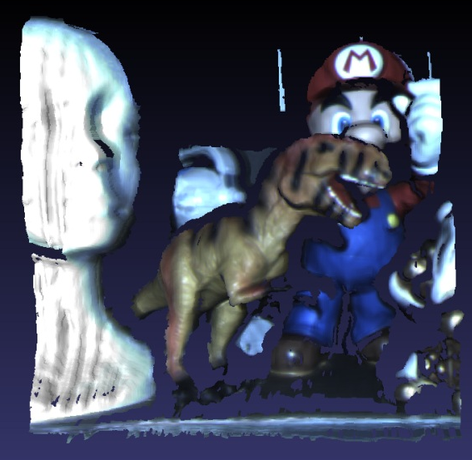
Introduction
Goal: automatic recognition of 3D models in RGB-D data with clutter and occlusions
Applications: object manipulation and grasping, robot localization and mapping, scene understanding, …
Different from 3D object retrieval because of the presence of clutter and occlusions
Global methods can not deal with that (segmentation..)
Local (feature-based) methods are usually deployed
?

Slide 3
Work Flow
Feature-based approach: 2D/3D features are detected, described and matched
Correspondences are fed to a Geometric Validation module that verifies their consensus to:
Understand wheter an object is present or not in the scene
If so, select a subset which identifies the model that has to be recognized
If a view of a model has enough consensus -> 3D Pose Estimation on the «surviving» correspondence subset
OFFLINE
MODEL
VIEWS
Feature
Detection
Feature
Description
SCENE
Feature
Detection
Feature
Description
Feature
Matching
Geometric
Validation
Best-view
Selection
Pose
Estimation

Slide 4
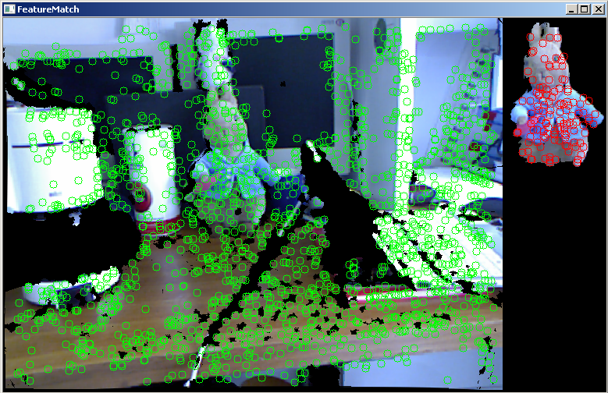
2D/3D feature detection
Double flow of features:
«2D» features relative to the color image (RGB)
«3D» features relative to the range map (D)
For both feature sets, the SURF detector [Bay et al. CVIU08] is applied on the texture image (often not enough features on the range map)
Features are extracted on each model view (offline) and on the scene (online)
OFFLINE
MODEL
VIEWS
Feature
Detection
Feature
Description
SCENE
Feature
Detection
Feature
Description
Feature
Matching
Geometric
Validation
Best-view
Selection
Pose
Estimation

Slide 5
2D/3D feature description
«2D» (RGB) features are described using the SURF descriptor [Bay et al. CVIU08]
«3D» (Depth) features are described using the SHOT 3D descriptor [Tombari et al. ECCV10]
This requires the range map to be transformed into a 3D mesh
2D points are backprojected to 3D using camera calibration and the depths
Triangles are built up using the lattice of the range map
OFFLINE
MODEL
VIEWS
Feature
Detection
Feature
Description
SCENE
Feature
Detection
Feature
Description
Feature
Matching
Geometric
Validation
Best-view
Selection
Pose
Estimation

Slide 6
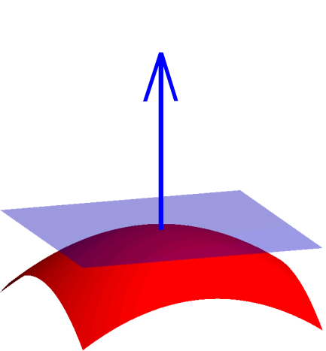
The SHOT descriptor
Hybrid structure between signatures and histograms
Signatures are descriptive
Histograms are robust
Signatures require a repeatable local Reference Frame
Computed as the disambiguated eigenvalue decomposition of the neighbourhood scatter matrix
Each sector of the signature structure is described with a histogram of normal angles
Descriptor normalized to sum up to 1 to be robust to point density variations.
Normal count
cos θ_{i}
θ_{i}
Robust local RF
OFFLINE
MODEL
VIEWS
Feature
Detection
Feature
Description
SCENE
Feature
Detection
Feature
Description
Feature
Matching
Geometric
Validation
Best-view
Selection
Pose
Estimation

Slide 7
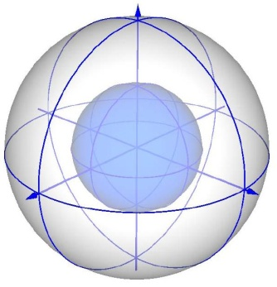
The C-SHOT descriptor
Extension to multiple cues of the SHOT descriptor
C-SHOT in particular deploys
Shape, as the SHOT descriptor
Texture, as histograms in the Lab colour-space
Same localRF, double description
Different measures of similarity
Angle between normals (SHOT) for shape
L1 norm for texture
…
…
Shape Step (S_{S)}
Color Step (S_{C})
CSHOT
Shape description
Texture description
OFFLINE
MODEL
VIEWS
Feature
Detection
Feature
Description
SCENE
Feature
Detection
Feature
Description
Feature
Matching
Geometric
Validation
Best-view
Selection
Pose
Estimation

Slide 8
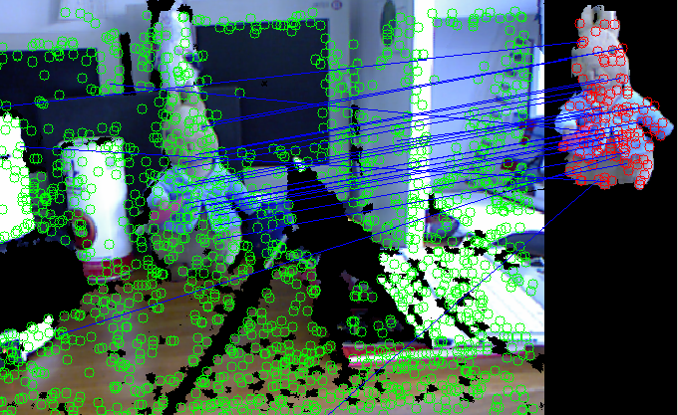
Feature Matching
The current scene is matched against all views of all models.
For each view of each model, 2D and 3D features are matched separately by means of kd-trees based on the Euclidean distance
This requires, at initialization, to build up 2 kd-trees for each model view
All matched correspondences (above threshold) are merged into a unique 3D feature array by backprojection of the 2D features.
OFFLINE
MODEL
VIEWS
Feature
Detection
Feature
Description
SCENE
Feature
Detection
Feature
Description
Feature
Matching
Geometric
Validation
Best-view
Selection
Pose
Estimation

Slide 9
Geometric Validation (1)
Approach based on 3D Hough Voting [Tombari & Di Stefano PSIVT10]
Each 3D feature is associated to a 3D local RF
We can define global-to-local and local-to-global transformations of 3D points
Local RF
Local RF
Global RF
Global RF
OFFLINE
MODEL
VIEWS
Feature
Detection
Feature
Description
SCENE
Feature
Detection
Feature
Description
Feature
Matching
Geometric
Validation
Best-view
Selection
Pose
Estimation

Slide 10
Geometric Validation (2)
Training:
Select a unique reference point (e.g. the centroid)
Each feature casts a vote (vector pointing to the reference point)
These votes are transformed in the local RF of each feature to be PoV-independent and stored:
: i-th vote in the global RF
OFFLINE
MODEL
VIEWS
Feature
Detection
Feature
Description
SCENE
Feature
Detection
Feature
Description
Feature
Matching
Geometric
Validation
Best-view
Selection
Pose
Estimation

Slide 11
Geometric Validation (3)
Online:
Each correspondence casts a 3D vote normalized by the rotation induced by the local RF
Votes are accumulated in a 3D Hough space and thresholded
Maximum/a in the Hough space identify the object presence (handles the presence of multiple instances of the same model)
Votes in each over-threshold bin determine the final subset of correspondences
SCENE
MODEL

Slide 12
Best-view selection and Pose Estimation
For each model, a best view is selected as that returning the highest number of «surviving» correspondence after the Geometric Validation stage
If the best view for the current model returns a number of correspondences higher than a pre-defined Recognition Threshold, the object is recognized and its 3D pose estimated
3D Pose Estimation is obtained by means of Absolute Orientation [Horn Opt.Soc.87]
RANSAC is used together with Absolute Orientation to additionally increase the robustness of the correspondence subset.
OFFLINE
MODEL
VIEWS
Feature
Detection
Feature
Description
SCENE
Feature
Detection
Feature
Description
Feature
Matching
Geometric
Validation
Best-view
Selection
Pose
Estimation

Slide 13
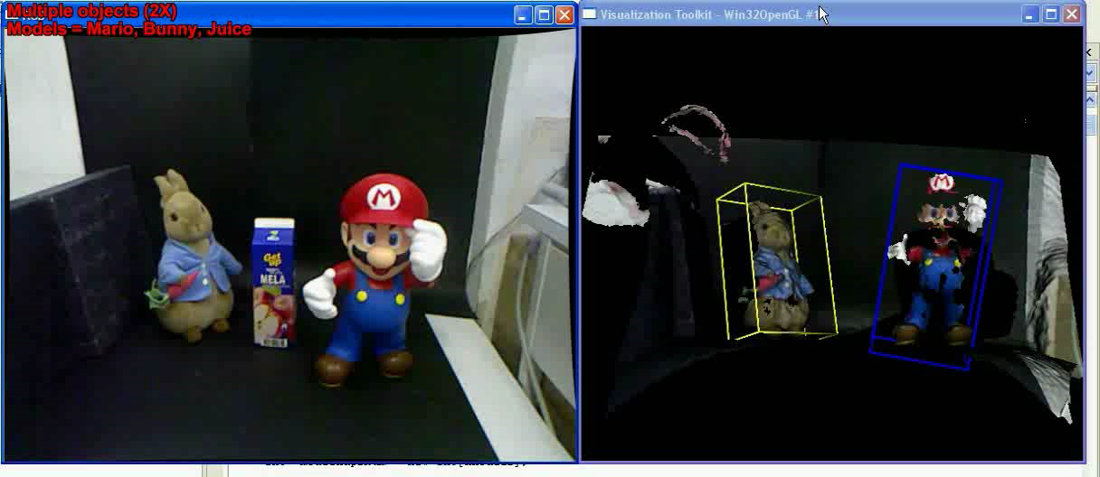
Demo Video
Showing 1 or 2 videos (kinect + stereo? )
Notes:
13

Slide 14

RGB-D object recognition and localization with clutter and occlusions
Thank you !
Federico Tombari, Samuele Salti, Luigi Di Stefano

